Slide 1
Assignment 3 Review
Database Concepts
Spring 2021
Week 7
Notes:
Course calendar!

Slide 2
Assignment 3
Due date: Oct. 13
Chapter 4 questions: 1-10, 12-16, 18, 19
Assignment 3 review questions: 2,3 , 6-15
SQL practice: (Q#10 -15)

Slide 3
A3Q2 - Ch4Q3
Given the business rule “an employee may have many degrees,” discuss its effect on attributes, entities, and relationships.
(Hint: Remember what a multivalued attribute is and how it might be implemented. Also composite keys may be used in some db designs)
Design 1:
EMP_NUM | EMP_LNAME | EMP_DEGREE
123 | Carter | AA, BBA
124 | O’Shanski | BBA, MBA, Ph.D.
125 | Jones | AS
126 | Ortez | BS, MS
Notes:
Multivalued attributes are attributes that can have many values.
a compound key is a key that consists of two or more simple keys that uniquely identify an entity occurrence.

Slide 4
Ch4Q3
Design 2:
EMP_NUM | EMP_LNAME | EMP_DEGREE1 | EMP_DEGREE2 | EMP_DEGREE3
123 | Carter | AA | BBA
124 | O’Shanski | BBA | MBA | Ph.D.
125 | Jones | AS
126 | Ortez | BS | MS
Notes:
creating a field for each expected value. It is an inappropriate "solution" as it creates unnecessary redundancies.

Slide 5
Ch4Q3
Design 3:
EMP_NUM | EMP_LNAME | EMP_AA | EMP_AS | EMP_BA | EMP_BS | EMP_BBA | EMP_MS | EMP_MBA | EMP_PhD
123 | Carter | X |  |  |  | X
124 | O’Shanski | X |  |  |  | X |  | X | X
125 | Jones |  | X
126 | Ortez |  |  |  | X |  | X
Notes:
creating a field for each expected value. It is an inappropriate "solution" as it creates unnecessary redundancies.

Slide 6
Ch4Q3
Table name: DERGEE
EMP_NUM | DEGREE_CODE | DEGREE_DATE | DEGREE_PLACE
123 | AA | May-1999 | Lake Sumter CC
123 | BBA | Aug-2004 | U. of Georgia
124 | BBA | Dec-1990 | U. of Toledo
124 | MBA | May-2001 | U. of Michigan
124 | Ph.D. | Dec-2005 | U. of Tennessee
125 | AS | Aug-2002 | Valdosta State
126 | BS | Dec-1989 | U. of Missouri
126 | MS | May-2002 | U. of Florida
Design 4:
Table name: EMPLOYEE
EMP_NUM | EMP_LNAME
123 | Carter
124 | O’S hanski
125 | Jones
126 | Ortez

Slide 7
A3Q3 - Ch4Q12
Discuss two ways in which the 1:M relationship between COURSE and CLASS can be implemented. (Hint: Think about relationship strength, weak vs. strong.) Fig 4.8
Weak (non-identifying) relationships
Primary key of the child entity does not contain a primary key component of the parent entity.
Strong (identifying) relationships
Exists when the PK of a child entity contains at least part of its primary key from a parent entity.
Notes:
Weak (Non-Identifying) Relationship
Entity is existence-independent of other entities
PK of Child doesn’t contain PK component of Parent Entity
Strong (Identifying) Relationship
Child entity is existence-dependent on parent
PK of Child Entity contains PK component of Parent Entity
Usually occurs utilizing a composite key for primary key

Slide 8
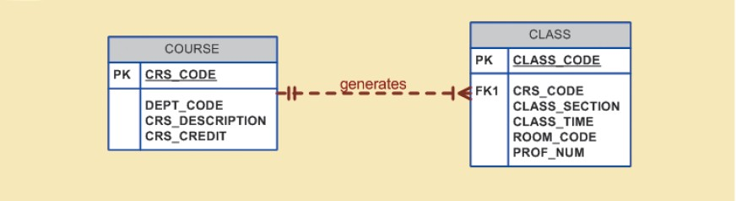
Figure 4.8 - A Weak (Non-Identifying) Relationship between COURSE and CLASS
Cengage Learning © 2015
Notes:
In this case, a weak relationship exists between COURSE and CLASS because CRS_CODE (the primary key of the parent entity) is only a foreign key in the CLASS entity. In this example, the CLASS primary key did not inherit a primary key component from the COURSE entity.

Slide 9
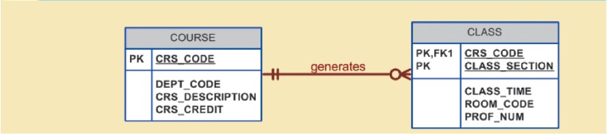
Figure 4.9 - A Strong (Identifying) Relationship between COURSE and CLASS
Cengage Learning © 2015
Notes:
In this case, the CLASS entity primary key is composed of CRS_CODE and CLASS_SECTION. Therefore, a strong relationship exists between COURSE and CLASS because CRS_CODE (the primary key of the parent entity) is a primary key component in the CLASS entity. In other words, the CLASS primary key did inherit a primary key component from the COURSE entity.

Slide 10
A3Q6 - Ch4Q9
What two courses of action are available to a designer when encountering a multivalued attribute? (Hint: give both the "very poor" solution, and the preferred solution.)

Slide 11
A3Q7 - Ch4Q13
How is a composite entity represented in an ERD, and what is its function? See Figure 4.23 or 4.25 to write out the tables and some attributes for the relationship of the composite entity. For example, TABLE_NAME (PK_ATTRIBUTE, ATTRIBUTE2...) TABLE_NAME2 (PK_ATTRIBUTE, ATTRIBUTE2...) etc.

Slide 12
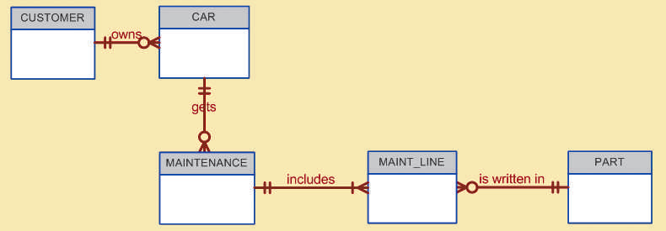
A3Q8 - Ch4Q5
Suppose you are working within the framework of the conceptual model in Figure Q4.5.
Write at least 5 the business rules that are reflected in it.
Notes:
Note that the apparent M:N relationship between MAINTENANCE and PART has been resolved through the use of the composite entity named MAINT_LINE.

Slide 13
A3Q9 - Ch4Q18
Write at least five business rules reflected in this ERD (see Fig. Q4.17).

Slide 14
SQL Practice for A3 Q10-15
Find the customer number, last name, first name, and current balance for every customer whose balance exceeds the credit limit
List the part number and description of every part that is in warehouse number 2 and that has more than 15 units on hand.
List the part number and price of every part that is classified as hardware or that costs more than $200.
Update the quoted price to $139.99, for the order line whose order_number is 12491, and whose quoted price is currently $149.99.
Remove all order lines having fewer than three parts ordered;
Add the following two records to the order table:
order_number: 12505, order_date: 12/22/2012, customer_number: 405
order_number: 12506, order_date: 12/24/2013, customer_number: 567

